Slide 1
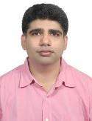
DR GAURAV MUKHIJA (MD)
LASER DERMATOLOGIST & COSMETOLOGIST
Dr Gaurav did his MBBS from AMU Aligarh and MD from Davangere
Dr Gaurav Mukhija has been practising Clinical Dermatology for the last 15 years in Gorakpur,UP.
He runs world class Laser & Cosmetic Center which has modern Lasers like DIODE, Qswitch Nd:YAG, CO2 Fractional laser & EXCIMER 308 Light
His clinic offers Dermatosurgery and all modern treatments for anti-ageing,facial rejuvenation, hair growth & vitiligo
He is involved in conducting various academic activities in Gorakhpur.

